Slide 1


Slide 2
The issue
In a test conducted among 2500 users of a particular software the median time spent on reading its End User Licence Agreement is 6 seconds.
By generating a confidence interval we can be 95% sure that 70% of users spend less than 12 seconds
Assuming it takes minimum of 2 minutes to read it in full; no more than 8% of users read it in full.
Companies take advantage of this User ignorance.
Youtube policy states that terms maybe changed any time at their discretion, without notice to the user

Slide 3
One such example
The Klear gear issue
Customer purchased item on Klear gear did not receive.
Tried calling company helpline, which did not exist.
Asked credit card to block payment until delivery.
Then receives product.
Few days later he is fined $50 to raise a dispute against the company which was illegal according to its Terms of Service.
The cruel thought is that the particular Policy was introduced after the product was received.
The sad part is that the user did not read it even the first time to be aware of the changes.
The Complaint Its Terms of Service

Slide 4
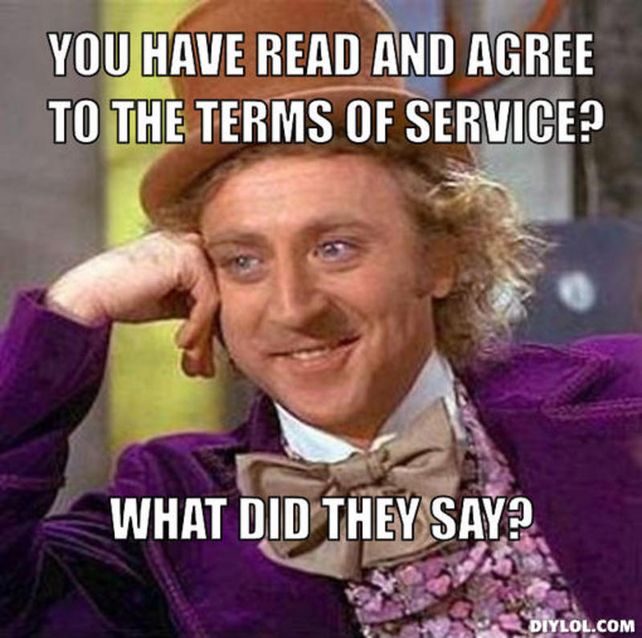
Existing remedies
There has been some efforts in the past to avoid such cases.
The website Docracy.com have programmed solutions that provide the website’s Terms of Service and its changes over time.
But to read them you need to log in to their websites which is highly unlikely when users rarely read what appears automatically in front of them.

Slide 5
Our idea
A Google Chrome extension running in background which tracks the currently visiting website for any changes in Terms of Service.
If any, a pop up will notify the user and if the user choose to see we display the exact changes highlighted along with the document.
The additions in Green and deletions in Red.
Fast process. Displays in few seconds

Slide 6
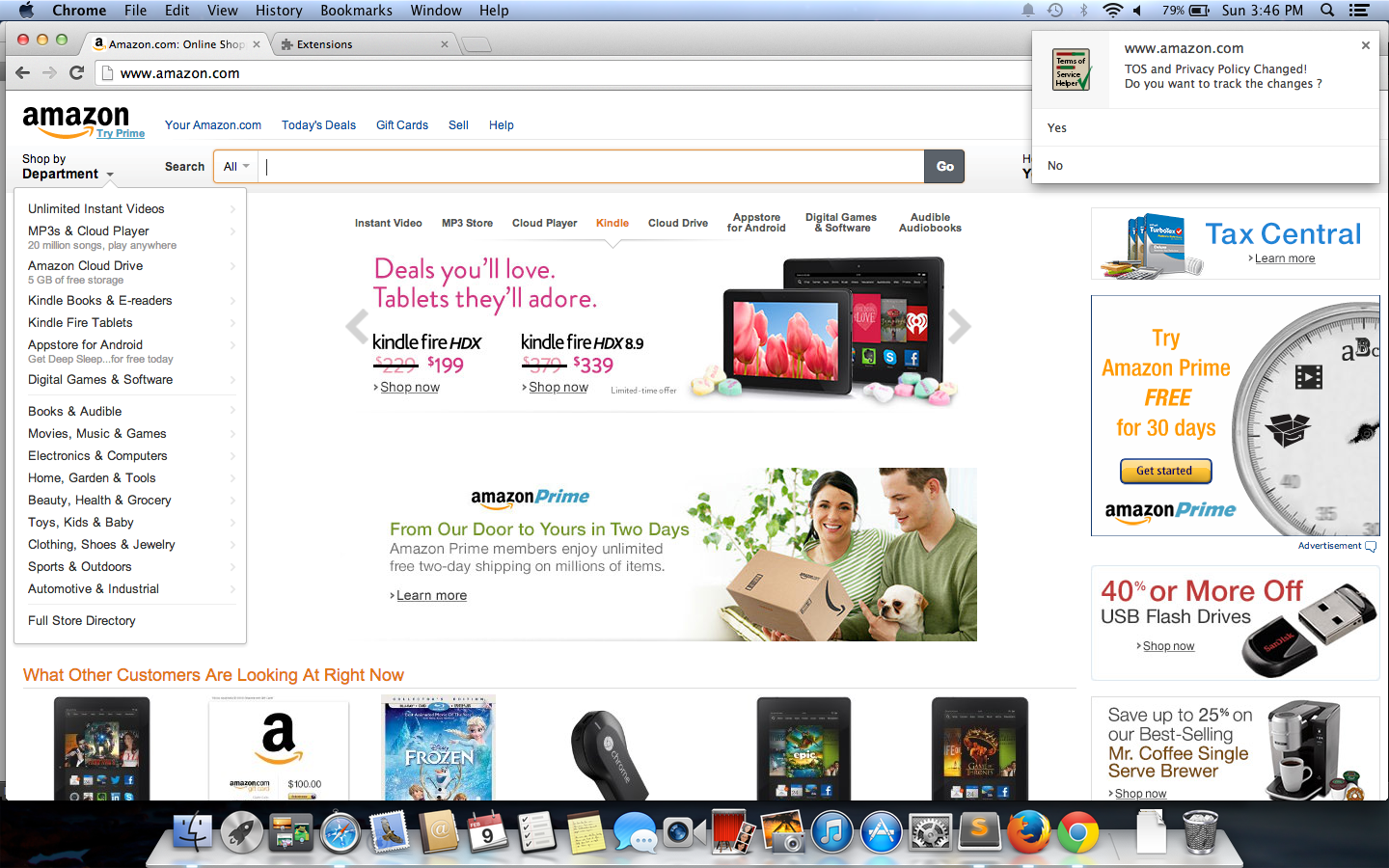

Slide 7
DEMO

